Slide 1
Real Estate Management System
Presented by:
Zaka Tabish Shaikh(210)
Shaikh Mohammed Mohammed sadeq (217)
Mohammed Faisal (230)
Mohammed abedi(229)

Slide 2
Introduction
This Software solution will ease the management of real estate businesses.
In Real Estate there are lots of calculations like keeping record of Properties in terms of location, rate, number of registered members, and especially calculations of Loan EMI calculation concept at the time of transaction etc. These calculations are not only complicated but also brain eating.
Our project also consists of individual detail of property,customer’s details, and feedback’s details.
So the owner can have all these details in his personal computers rather than having hundreds of registers.

Slide 3
Proposed System Feature
The proposed system will be developed using vs code and SQL Server as a back end database.
Frontend will be a dynamic website with interactive UI build using html css js and its frameworks.
Other features will include feedback page, comments sections, Online live auction and negotiation page.

Slide 4
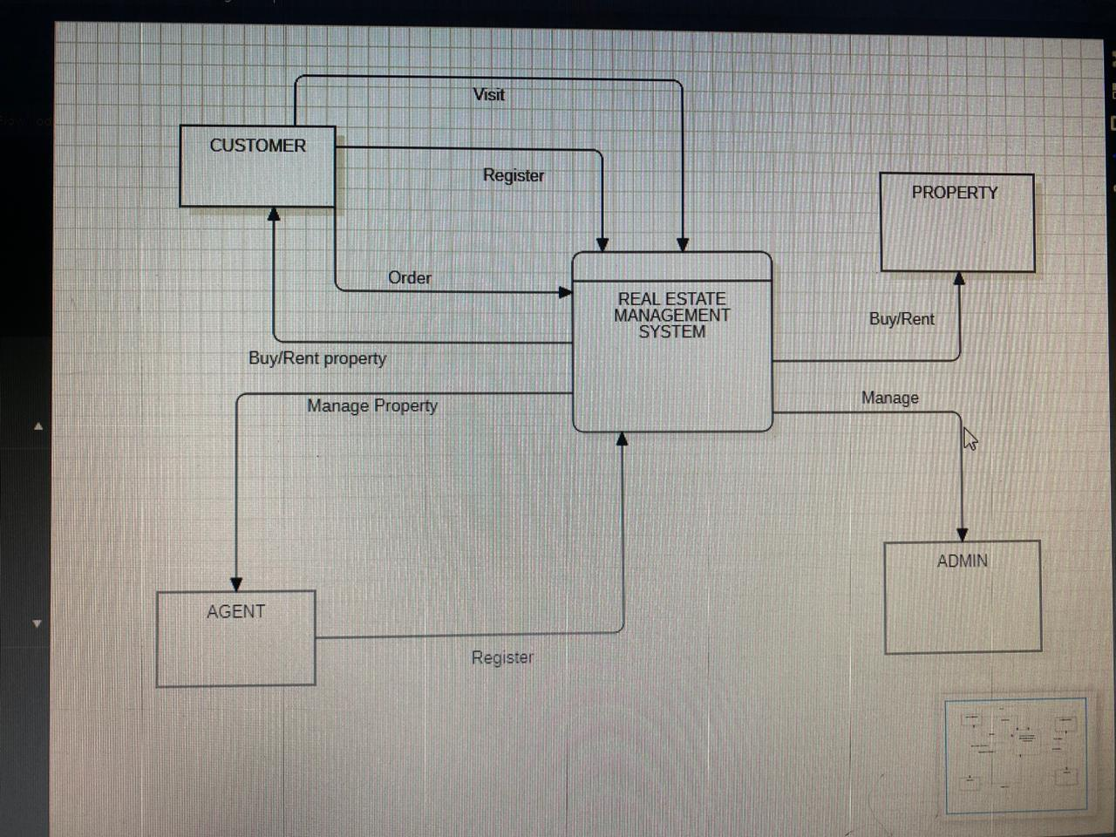
Basic data-flow diagram:

Slide 5
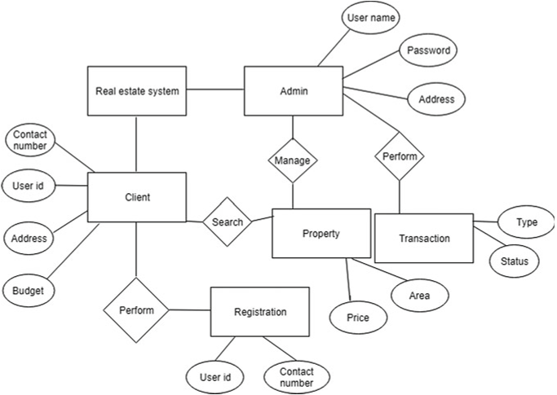
ER diagram

Slide 6
Advantages:
No need unnecessary paperwork.
Automatic management.
Fewer number of employees required for maintenance
Low cost maintenance.
Can be managed from any part of the world.
No requirement of infrastructure for office.
Fastest negotiation and auctioning.
All records online.
Searching and sorting capability with a click.
Data analysis can be done without hesitation.

Slide 7
Disadvantages:
Fewer number of people will be involved leading to unemployment.
All data is loaded on the server that can be hacked and misused.
If website went down work can come to halt instantly.
Technical knowledge is required for operation.

Slide 8
Conclusion:
The Following project will help us simplify the process of Real Estate.
The software solution we are designing that helps the Developer to handle those task that had been handled manually.
This Project will ease the work of the owner as he can have all these details in his personal computers rather than having hundreds of registers and paperwork.
The most important feature of this system is online exhibiting the properties, This saves time to visit at the actual place where the property is located.

